Slide 1
Lecture 1
Numerical differentiation

Slide 2
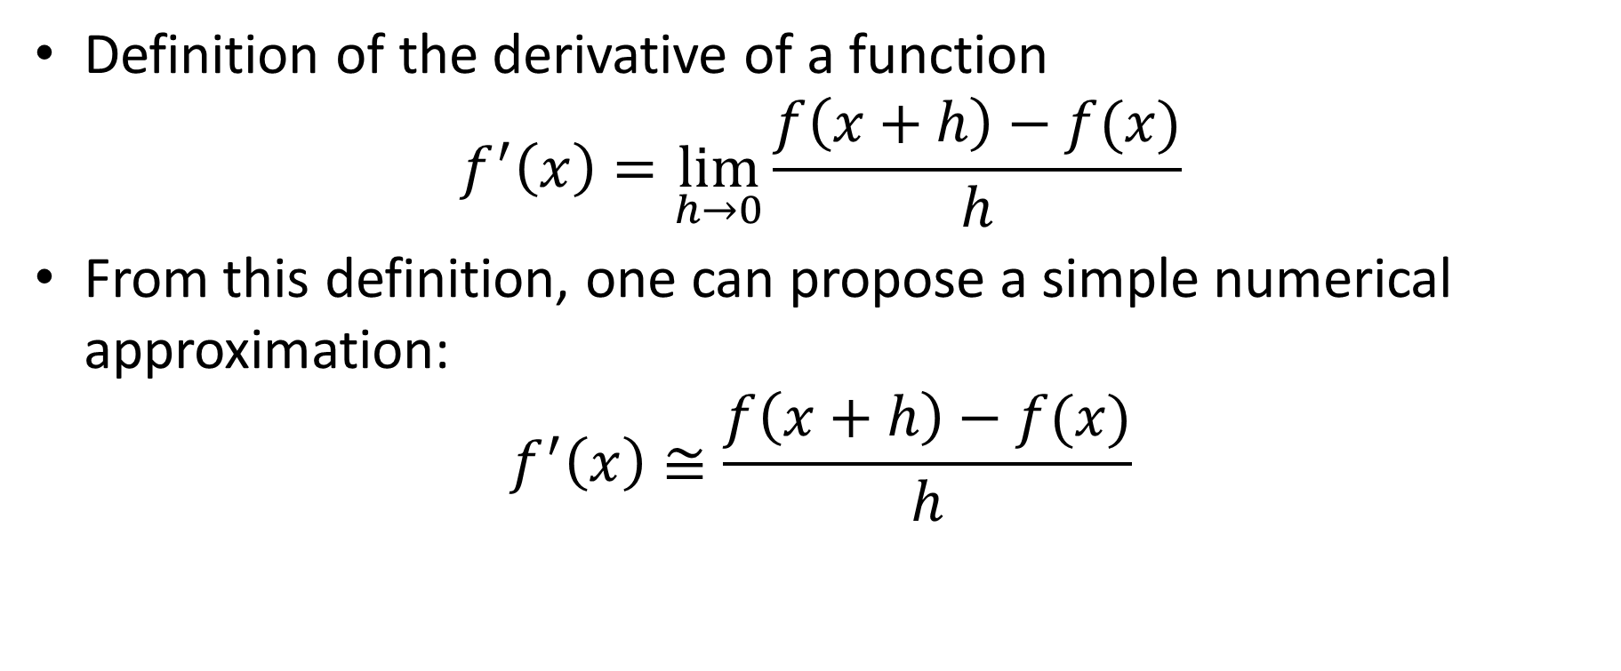
Introduction
Definition of the derivative of a function
$$f^{′}\left(x\right)=\lim_{h→0}{\frac{f\left(x+h\right)−f(x)}{h}}$$
From this definition, one can propose a simple numerical approximation:
$$f^{′}\left(x\right)≅\frac{f\left(x+h\right)−f(x)}{h}$$
Notes:
In your calculus classes you learned the definition of the derivative of a function f.
Based on this definition one can right away propose a simple numerical approximation for the derivative
$$f^{′}\left(x\right)≅\frac{f\left(x+h\right)−f(x)}{h}$$

Slide 3
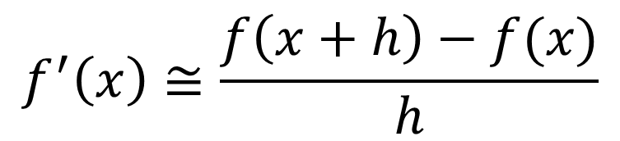
Introduction
There are however two major problems with this:
The formula doesn’t tell anything about how large/small is the error
The expression is very sensitive to round-off errors
$$f^{′}\left(x\right)≅\frac{f\left(x+h\right)−f(x)}{h}$$
Two very similar number
“0”/”0”
A very small number
Notes:
There are however two major problems with this expression
First problem: The formula doesn’t tell anything about how large/small is the error
Second problem: The expression is very sensitive to round-off errors
Indeed, to get a good approximation of the rigorous limit process, one must choose a small value for h.
But then we get on the numerator the difference between two very similar numbers, which numerically is prone to loss of significance.
On the numerator we divide by a very small number
In summary we do everything one should avoid when evaluating numerically an expression:
Subtract two similar numbers and divide by a small number
We end up with an expression of the type “0/0”, which numerically will be extremely sensitive to round-off errors.

Slide 4
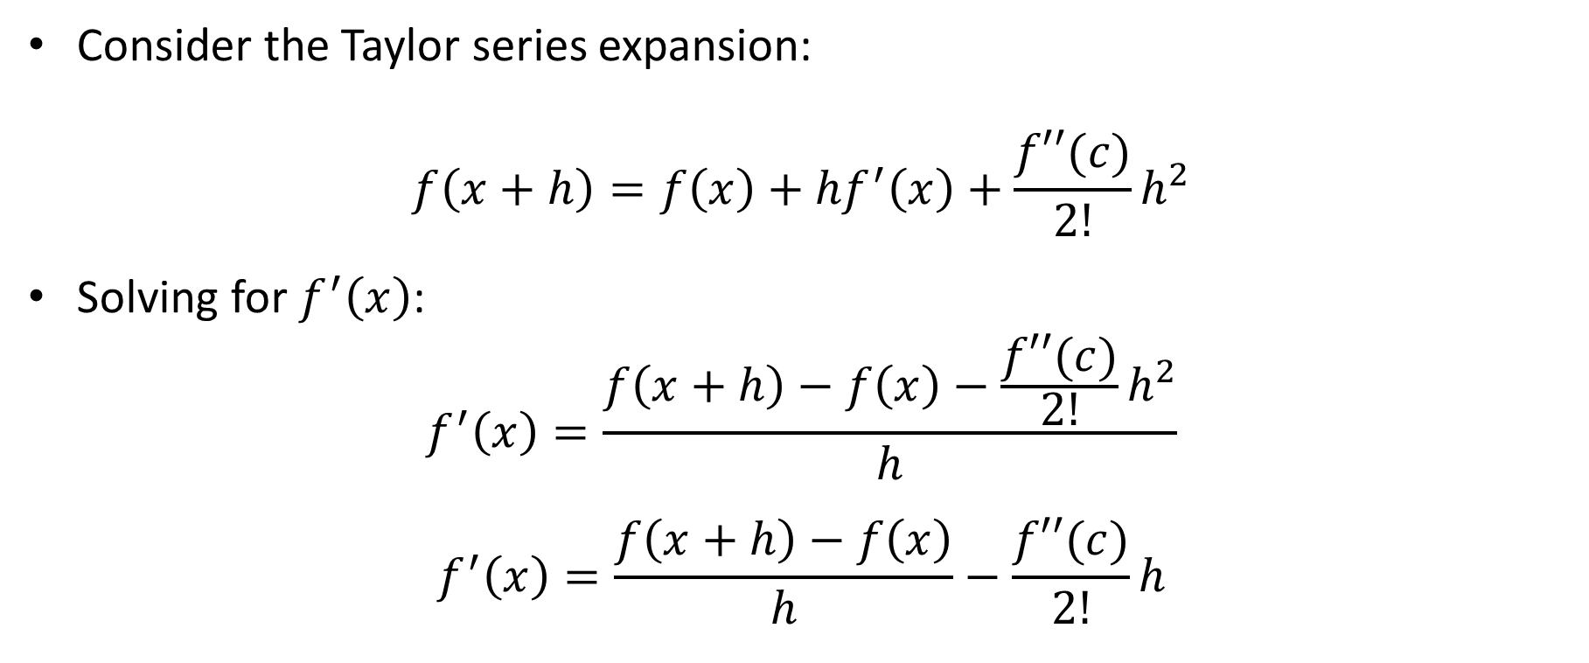
Taylor series for differentiation formulas
Consider the Taylor series expansion:
$$f\left(x+h\right)=f\left(x\right)+{hf}^{′}\left(x\right)+\frac{f′′(c)}{2!}h^{2}$$
Solving for $f^{′}\left(x\right)$:
$$f^{′}\left(x\right)=\frac{f\left(x+h\right)−f\left(x\right)−\frac{f′′(c)}{2!}h^{2}}{h}$$
$$f^{′}\left(x\right)=\frac{f\left(x+h\right)−f\left(x\right)}{h}−\frac{f′′(c)}{2!}h$$
Notes:
The previous observations motivate the development of better approximations for the derivative of a function
They can be developed by using Taylor series expansion of the expression f(x+h).
Consider for example the Taylor series expansion of f(x+h) to the second order.
Solving for f’(x) allows to find the formula
$$f^{′}\left(x\right)=\frac{f\left(x+h\right)−f\left(x\right)−\frac{f′′(c)}{2!}h^{2}}{h}$$
with c a number between x and x+h
After simplification we obtain
$$f^{′}\left(x\right)=\frac{f\left(x+h\right)−f\left(x\right)}{h}−\frac{f′′(c)}{2!}h$$

Slide 5
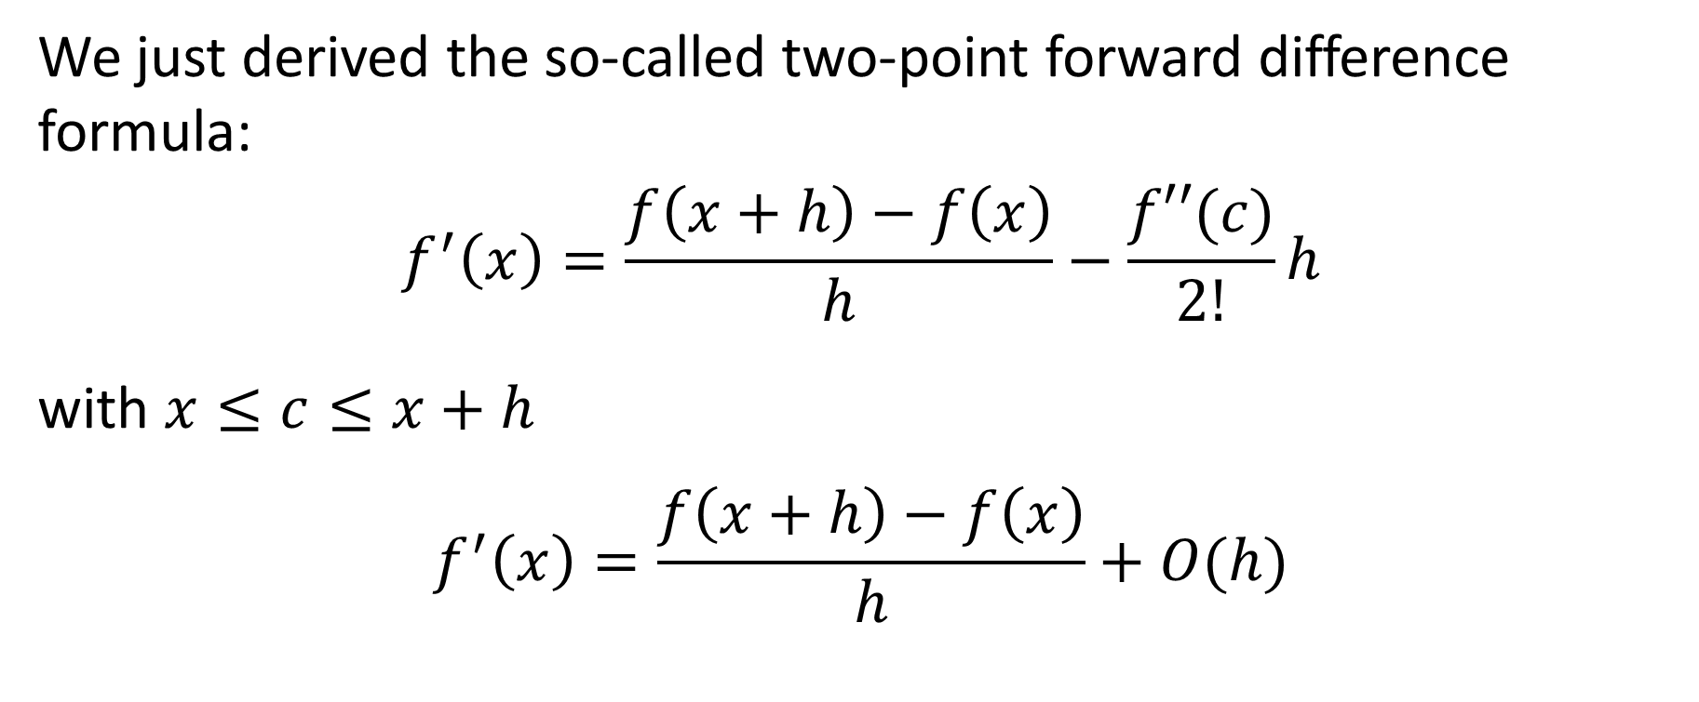
Two-point forward difference formula
We just derived the so-called two-point forward difference formula:
$$f^{′}\left(x\right)=\frac{f\left(x+h\right)−f\left(x\right)}{h}−\frac{f′′(c)}{2!}h$$
with $x≤c≤x+h$
$$f^{′}\left(x\right)=\frac{f\left(x+h\right)−f\left(x\right)}{h}+O(h)$$
Truncation error
Notes:
We just derived the so-called two-point forward difference formula.
On one side we have the approximation formula for the first derivative but as benefit we get an estimation of the truncation error.
We can observe that the truncation error is proportional to h, or in other words in first order of h, which is summarized by the big O notation O(h).

Slide 6
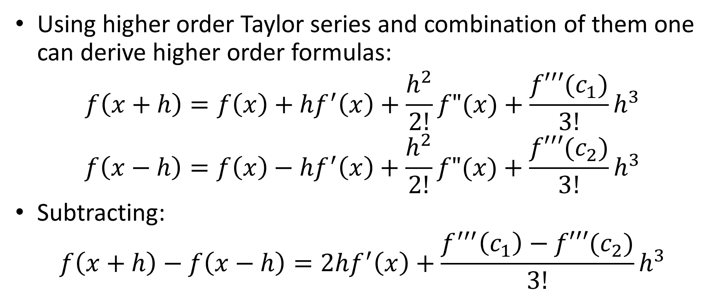
Higher order formulas
Using higher order Taylor series and combination of them one can derive higher order formulas:
$$f\left(x+h\right)=f\left(x\right)+{hf}^{′}\left(x\right)+\frac{h^{2}}{2!}f"(x)+\frac{f′′′(c_{1})}{3!}h^{3}$$
$$f\left(x−h\right)=f\left(x\right)−{hf}^{′}\left(x\right)+\frac{h^{2}}{2!}f"(x)+\frac{f′′′(c_{2})}{3!}h^{3}$$
Subtracting:
$$f\left(x+h\right)−f\left(x−h\right)=2{hf}^{′}\left(x\right)+\frac{f^{′′′}\left(c_{1}\right)−f′′′(c_{2})}{3!}h^{3}$$
Notes:
Using higher order Taylor series and combination of them one can derive higher order formulas
For example consider the Taylor series expansion of f(x+h) and f(x-h) to the third order
Subtracting the two series yields to
$$f\left(x+h\right)−f\left(x−h\right)=2{hf}^{′}\left(x\right)+\frac{f^{′′′}\left(c_{1}\right)−f′′′(c_{2})}{3!}h^{3}$$
with the number c1 between x and x+h and c2 between x-h and x.

Slide 7
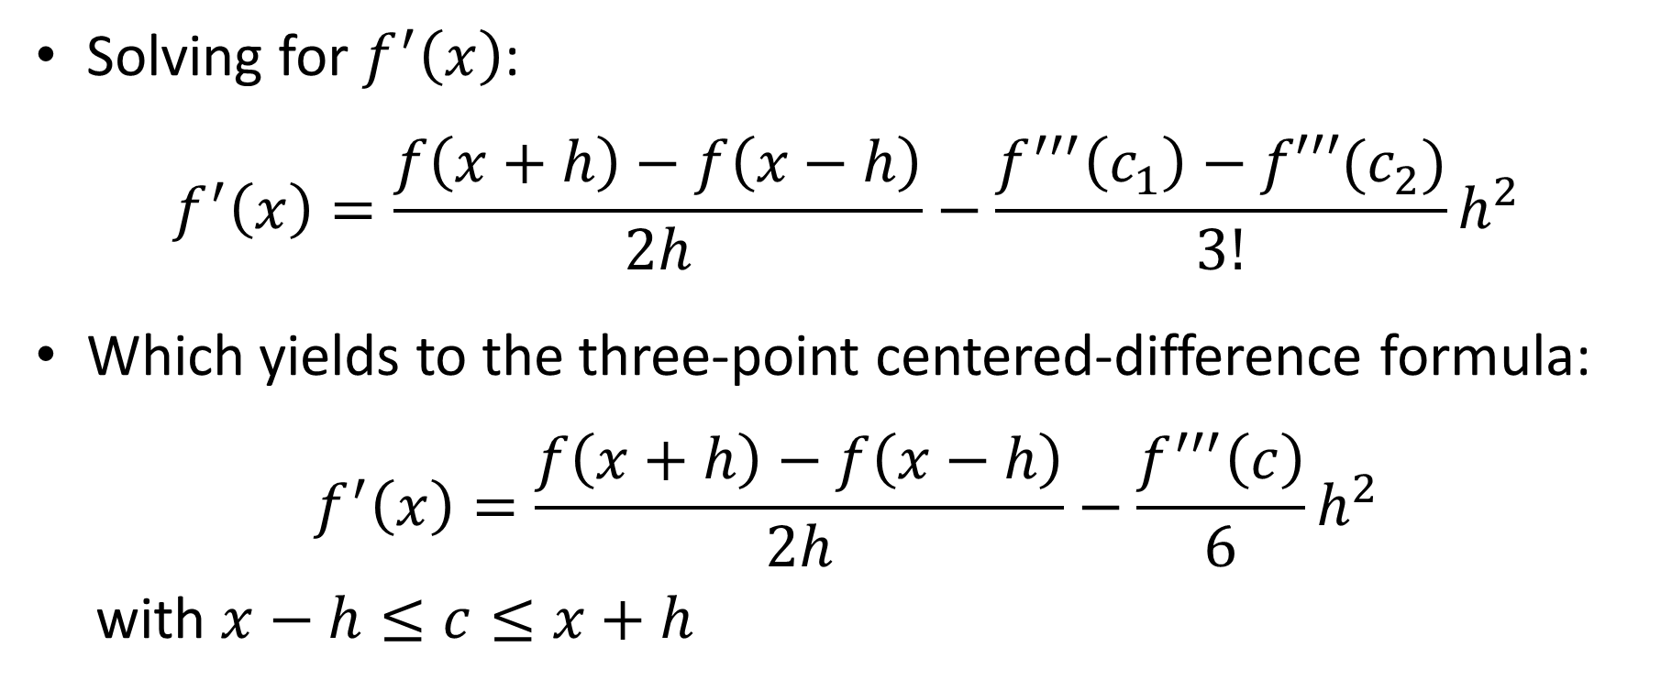
Higher order formulas
Solving for $f^{′}\left(x\right)$:
$$f^{′}\left(x\right)=\frac{f\left(x+h\right)−f\left(x−h\right)}{2h}−\frac{f^{′′′}\left(c_{1}\right)−f′′′(c_{2})}{3!}h^{2}$$
Which yields to the three-point centered-difference formula:
$$f^{′}\left(x\right)=\frac{f\left(x+h\right)−f\left(x−h\right)}{2h}−\frac{f^{′′′}\left(c\right)}{6}h^{2}$$
with $x−h≤c≤x+h$
Notes:
Solving for f’(x) yields to the three-point centered-difference formula.
Note that we have replaced $f^{′′′}\left(c_{1}\right)−f′′′(c_{2})$ by $f^{′′′}\left(c\right)$ with c a number between x-h and x+h.
Note that this formula is in order h square.
This is more precise than the previously derived formula.

Slide 8
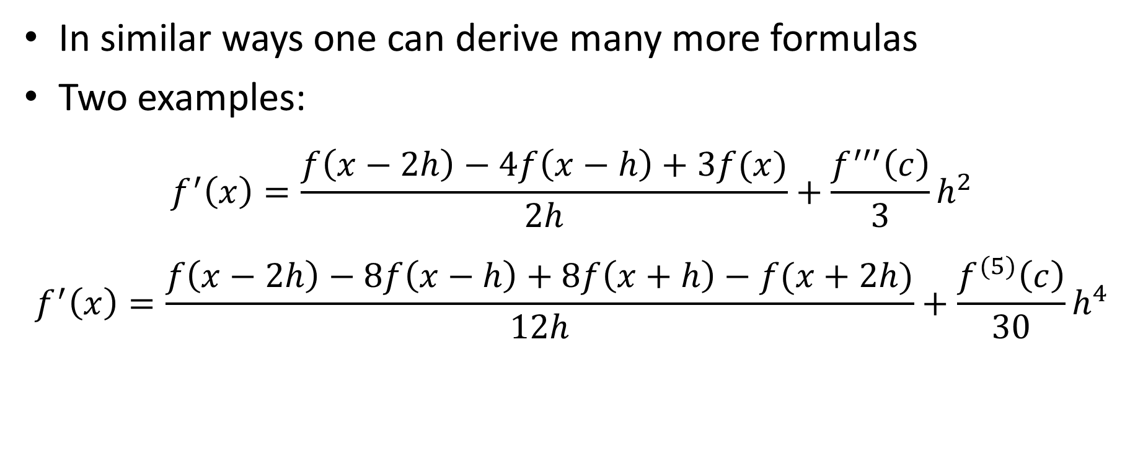
Higher order formulas
In similar ways one can derive many more formulas
Two examples:
$$f^{′}\left(x\right)=\frac{f\left(x−2h\right)−4f\left(x−h\right)+3f(x)}{2h}+\frac{f^{′′′}\left(c\right)}{3}h^{2}$$
$$f^{′}\left(x\right)=\frac{f\left(x−2h\right)−8f\left(x−h\right)+8f\left(x+h\right)−f(x+2h)}{12h}+\frac{f^{(5)}\left(c\right)}{30}h^{4}$$
Notes:
In similar ways one can derive many more formulas
On the slide are displayed two examples.
The first one is in order two whereas the second one in in order 4.
You may wish to try to derive them using combinations of Taylor series expansions in f(x-2h), f(x-h), f(x+h) and f(x+2h) up to order five.
It is a little lengthy to do, but you may want at least to do part of the work to get the idea
Note that this higher order formulas still divide by h, which remains a small number.
However, as they are of higher order, one can get an answer to a desired precision with less small numbers of h.
Consequently, we can partially address the issue of round-off errors as one can use not too small numbers h.
This aspect will be discussed in more details in the next lecture.

Slide 9
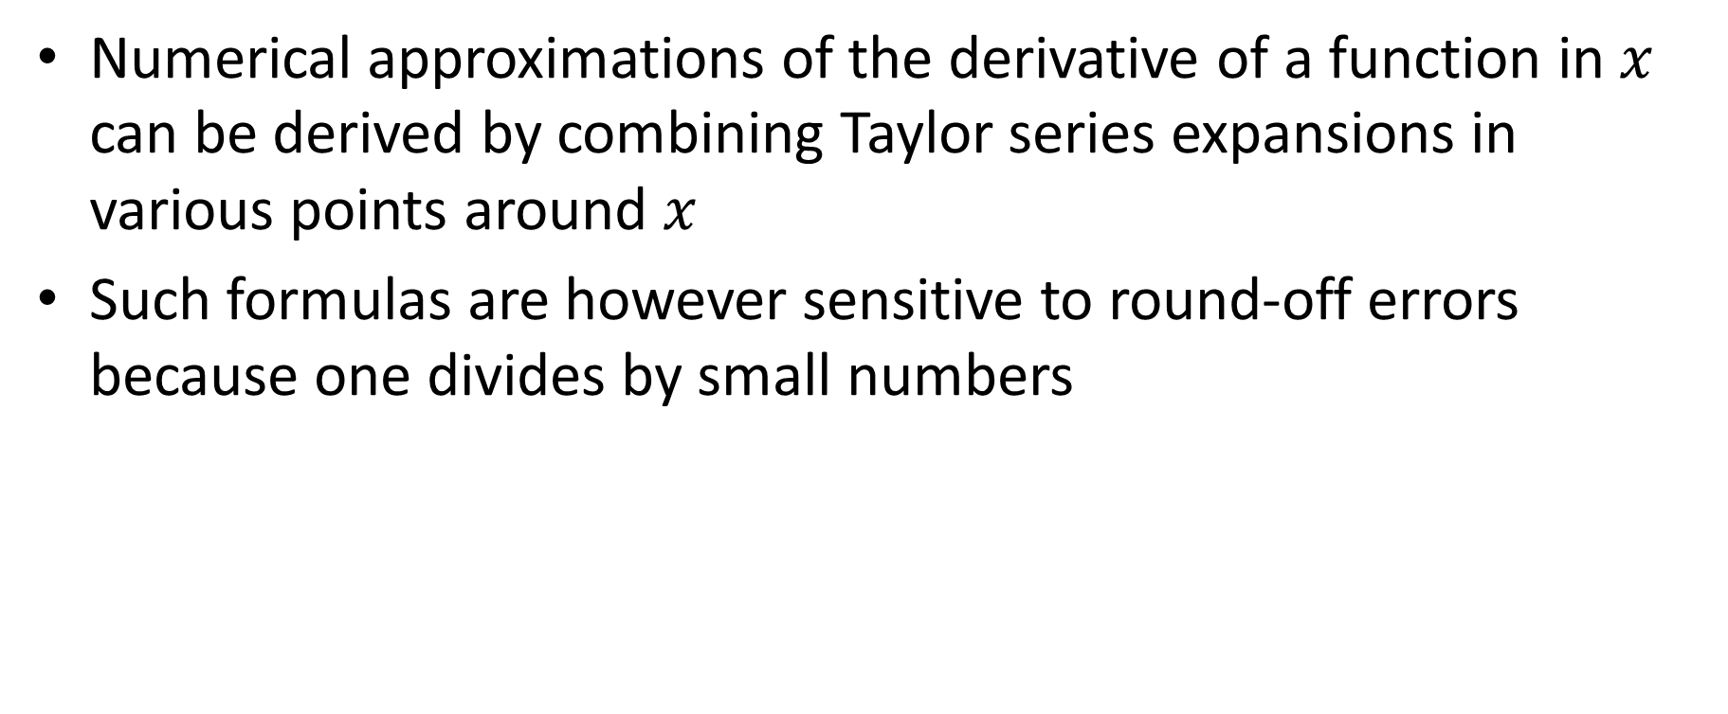
Summary
Numerical approximations of the derivative of a function in $x$ can be derived by combining Taylor series expansions in various points around $x$
Such formulas are however sensitive to round-off errors because one divides by small numbers
Notes:
Let us summarize the key findings
- Numerical approximations of the derivative of a function in $x$ can be derived by combining Taylor series expansions in various points around $x$
- Such formulas are however sensitive to round-off errors because one divides by small numbers

